Slide 1
ROCK
A MIRROR OF HISTORY AND SOCIETY

Slide 2
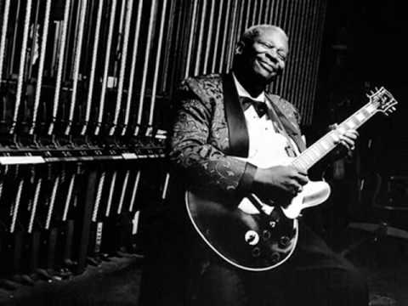
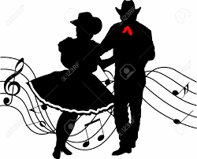
Rock was born from a fusion of Blues and country music
Blues represents the black slaves’ rebellion
Country music is a typical American music, of Irish origins.

Slide 3
Elvis presley
From youtube.com

Slide 4
Elvis the pelvis
He was born in Memphis where there is still his house
He is considered the beginner of rock music.
He merged blues rythm and a country image in his look
He transformed the way of dancing, moving his body, especially his pelvis as nobody has done before.
With him, rock music started to be considered a devil expression, with young people who didn’t go to the church on Sundays.

Slide 5
II World war: 1939-1942

Slide 6
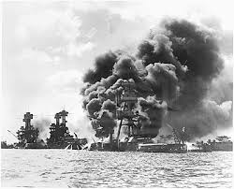
1942: American base in Pearl harbour is attacked by japan and Americans entered the war

Slide 7
In 1944 Americans arrive in europe and impose their music

Slide 8
The sixties
MARTIN LUTHER KING
THE BEATLES
Economical boom
In the USA the Blacks started a no-violent struggle to gain their civil rights.
M.L.King was their leader
Their rock is light, different from the Americn one.
Beatles mania started.
They wore as common people wore.
Europeans are optimistic because there is a great devolopment in economy. All families start to have housewares.

Slide 9
1955: the war in vietnam begins
The war started in 1955 and finished in 1975. Europeans were informed about it in the sixties.
The Beatles ridiculized this war.
They started wearing colourful uniforms as a sort of escape from reality.
Even their music changed.
They won’t do any more videos, and they started refusing society.

Slide 10
1969: the rolling stones
The new American groups, such as Rolling Stones, don’t refuse society. On the contrary they are politically involved and they scream to revolt against society.

Slide 11
1969: the first woodstock festival
For the first time, music gives a real political message. During this festival Jimmy Hendrix proposed a distorsion of the the American hymn, made of sounds of bombing, of planes flying, of screams and ambulances.

Slide 12
1970: john lennon
Beatles as a group don’t exist anymore. John Lennon, as a solo singer, produces a song with an only sentence, a specific political and social aim, and few instruments:
ALL WE ARE SAYING
IS GIVE PEACE A CHANCE

Slide 13
He also wrote one of the most beautiful song ever written: imagine
It deals with the search for a better world:
A world without nations where differences and religions don’t matter
A world with nothing to kill and die for
Where all men live together as one

Slide 14
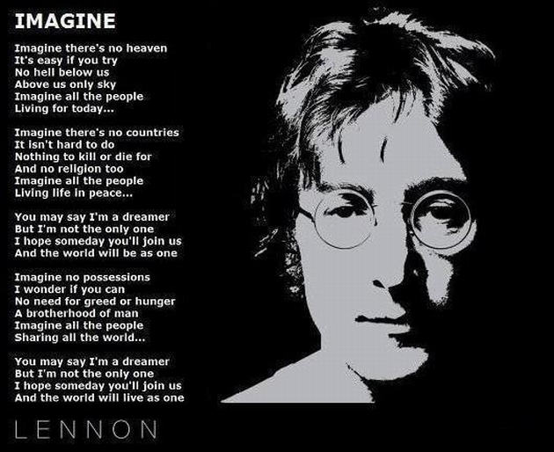

Slide 15
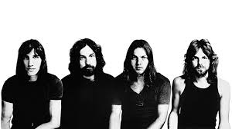
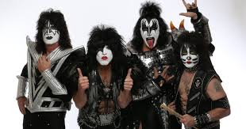
Seventies and eighties
The war in Vietnam finished in 1975. People all over the world felt betrayed.
It’s the period of the birth of new groups:
Pink Floyd
AC/DC
Kiss
Sex Pistols

Slide 16
At the end of the seventies there was the first video clip:

Slide 18
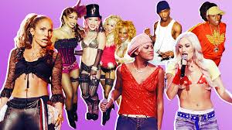
Eighties
But most of all POP was born (there is no more musical virtuosism, but the artists become performers)
The war of Vietman has finished.
People think the need enjoyment.
MTV channel was born.

Slide 19
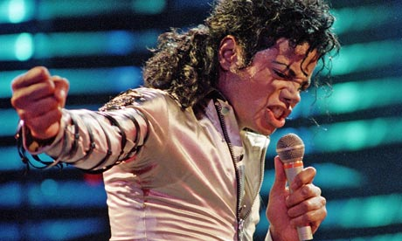
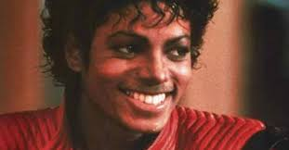
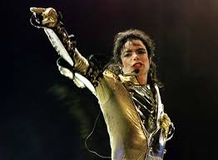
IT’s Michael jackson’s period
With his album «Thriller» he sold 160 million copies and the video was one of the greatest success ever.

Slide 20
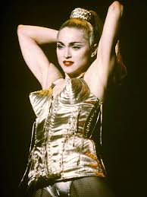
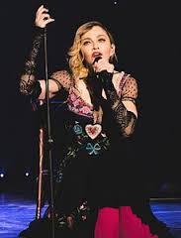
MADONNA

Slide 21
PLACE AND DATE OF BIRTH: BAY CITY, MICHIGAN IN 1958
FIRST ALBUM: «MADONNA» IN 1983
FIRST FILM: «DESPERATELY SEEKING SUSAN» IN 1985. She wasn’t the main actress but the film was very good for her carreer.
SHE HAS BEEN MARRIED AND DIVORCED TWICE AND SHE HAS TWO CHILDREN.
SHE HAS BEEN OFTEN CRITICISED FOR HER TRANSGRESSIVE USE OF RELIGIOUS SYMBOLS AND PROVOCATIVE IMAGES IN HER VIDEOS AND CONCERTS
SHE HAS INFLUENCED MANY FEMALE POP STARS SUCH AS BRITNEY SPEARS, SHAKIRA AND CHRISTINA AGUILERA

Slide 22
And many others such as
CHRISTINA AGUILERA
SPICE GIRLS
BACKSTREET BOYS

Slide 23
1991
WE CAN SAY THAT WITH FREDDIE MERCURY’S DEATH, WE ALSO HAVE THE DEATH OF CLASSICAL ROCK

Slide 24
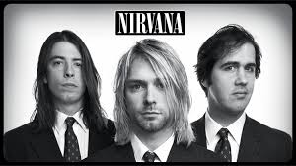
nineties
A symbol of Grange are Nirvana
«Grange» was born. The word means «shabby».
It’s the period of the First Gulf War.

Slide 25
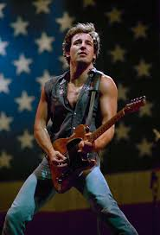
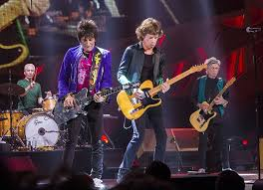
Rock survives in artists such
BRUCE SPRINGSTEEN
ROLLING STONES

Slide 26
AND U2, politically involved
SUNDAY BLOODY SUNDAY - 1981
PRIDE (IN THE NAME OF LOVE) - 1984
SILVER AND GOLD - 1988
ABOUT MASSACRES DURING THE IRISH CIVIL WAR
A TRIBUTE TO MARTIN LUTHER KING
AGAINST APARTHEID IN SOUTHAFRICA

Slide 27
2000
Rock is now difficult to be understood. Its icon is Amy Whinehouse. The artist is a person full of problems. Rythm comes back to its origins, to blues.

Slide 28
Hard rock cafe’
On the 22nd of December we went to Hard Rock Cafe in Rome, a chain of restaurants where you can eat burgers American style. On the walls there are memorabilia, which are objects once belonging to important rock singers and bands.

Slide 29
Third classes of the middle high school: sections i and l

Slide 30
THESE ARE SOME MEMORABILIA IN HARD ROCK CAFE’ IN ROME
JOHN LENNON’S RAINCOAT
BRUCE SPRINGSTEEN’S GUITAR
ELVIS PRESLEY’S JACKET

Slide 31
By Le classi terze sez. i - L
Con la collaborazione della prof.ssa Rizzo

